Slide 1
Introduction to GitHub

Slide 2
Welcome to Front End!

Slide 3
TODO
Visual Studio Code – An IDE
Create a GitHub Account and email me a link to your profile: GrahamE@ywcanwil.org
GitBash – A tool for interacting with GitHub

Slide 4
What is a Version Control System (VCS)?
Allow for tracking changes to code, collaborating, and sharing
Tools for creating experimental workspaces, and rolling back changes that do not work as intended
The easiest way to integrate multiple collaborators contributions to a project

Slide 5
Why GitHub?
GitHub is the most used VCS in the Tech Industry (~80% market share)
Any time you need to collaborate, or even work independently, GitHub will almost always be where your code ends up
GitHub Pages
Allows you to host a website for free!
Your website will be available for everyone to see in both its rendered form and as its source code
GitHub is a great way to show off your work to employers

Slide 6
GitHub Essentials
Repositories
Essentially a project folder (or folders) where you keep all of your code
Collaborative or Individual
Stored in “the cloud”, so your work will be available to you anywhere!

Slide 7
GitHub Essentials
Branches
A section of a repository that is isolated from all other sections
These help prevent you from making an errors in the code that is running
Most repositories have at least 2 branches: main and experimental

Slide 8
GitHub Essentials
Merging
Once you have tested the code on your experimental branch, you will want to copy it over to your main branch, where you run your already functional code
Merging will push your changes from your experimental branch to your main branch
GitHub will track the changes to your branches and keep a record of all versions

Slide 9
GitBash
A Command Line Interface (CLI) that is to interact with our GitHub repositories
Unix style – it will look and feel like the Linux Operating System
Runs by entering commands that tell the computer what to do
GitBash allows us to deploy our code to GitHub

Slide 10
GitBash Common Commands
ls
Lists directory (folder) contents
cd
Changes the directory (folder) that you are currently looking in
After cd, list the folder you would like to be shown
Supports relative paths
mv
Moves or renames a file or directory
You can move many files at one time
Provide filepath to new directory after the filename

Slide 11
GitBash Common Commands
Clone
Creates a clone of a repository you created online, but on your pc in the folder you specify
After you create a repository on GitHub, this will be the first command you use to interact with it
Branch
Creates a new branch for you to work in
Switch
Changes the branch you are currently using

Slide 12
GitBash Common Commands
add
Adds a file (or files) to a staging area so you can commit them
Creates a snapshot of file(s)
commit –m ”A descriptive message”
Records snapshots in version history
push
Uploads local branch commits from staging area
Last step to update your repository

Slide 13
GitBash Common Commands
pull
Updates your current local branch with any new contributions to the branch
Make sure you call pull before you begin working on a repository to avoid merge conflicts

Slide 14
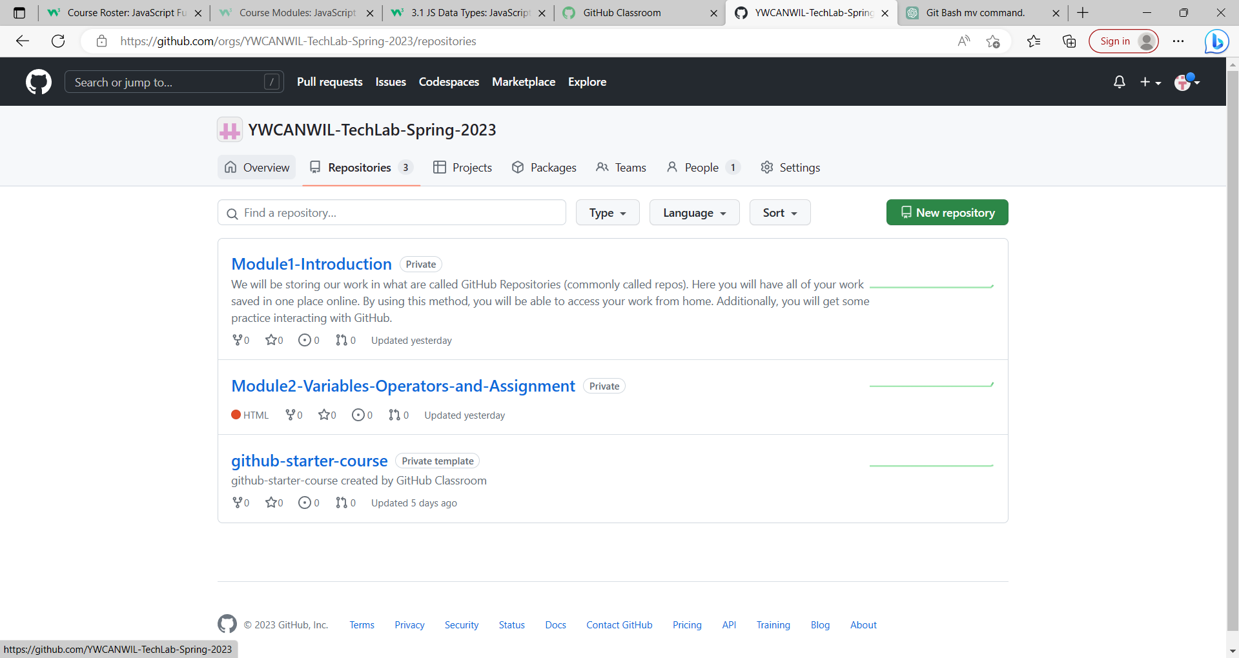
Creating a Repository
Go to your GitHub Profile and Select the Repositories tab
Click the New Repository button

Slide 15
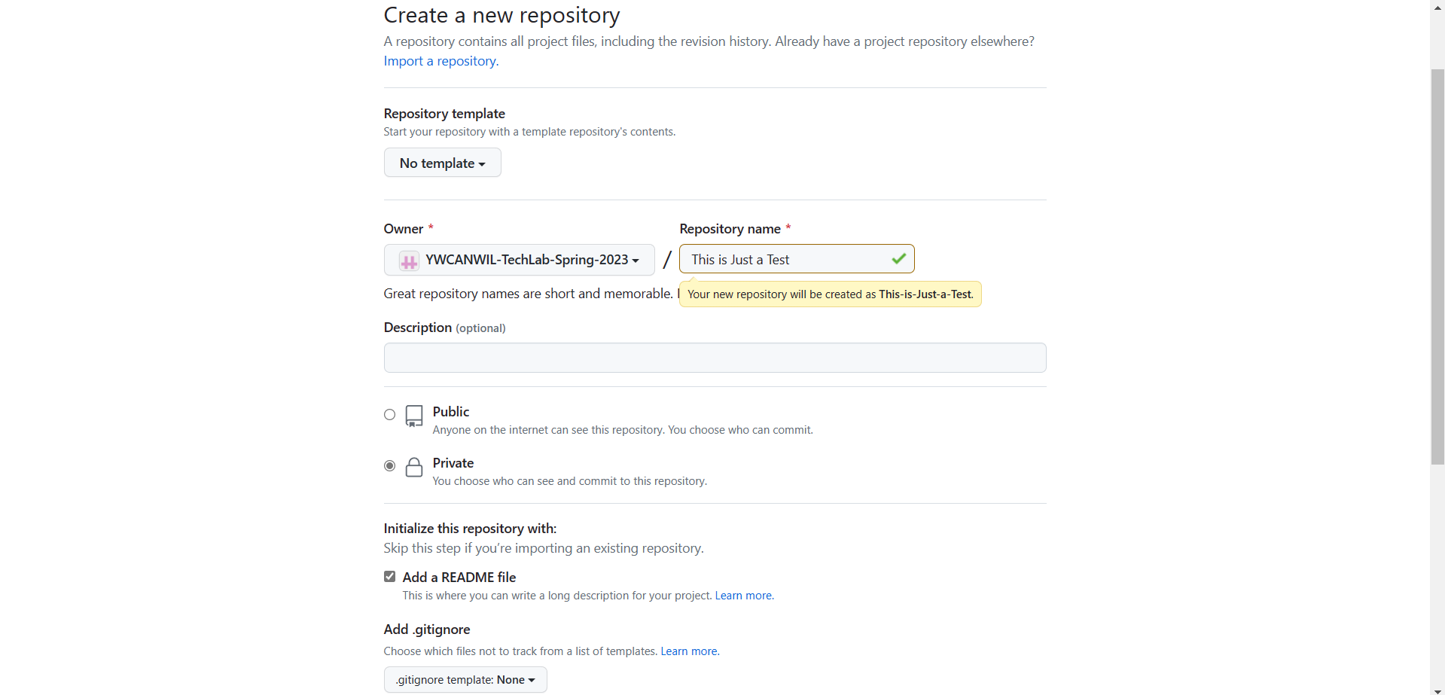
Creating a Repository
Choose a name for your repository
Select Public or Private
Click the box for Add README file

Slide 16
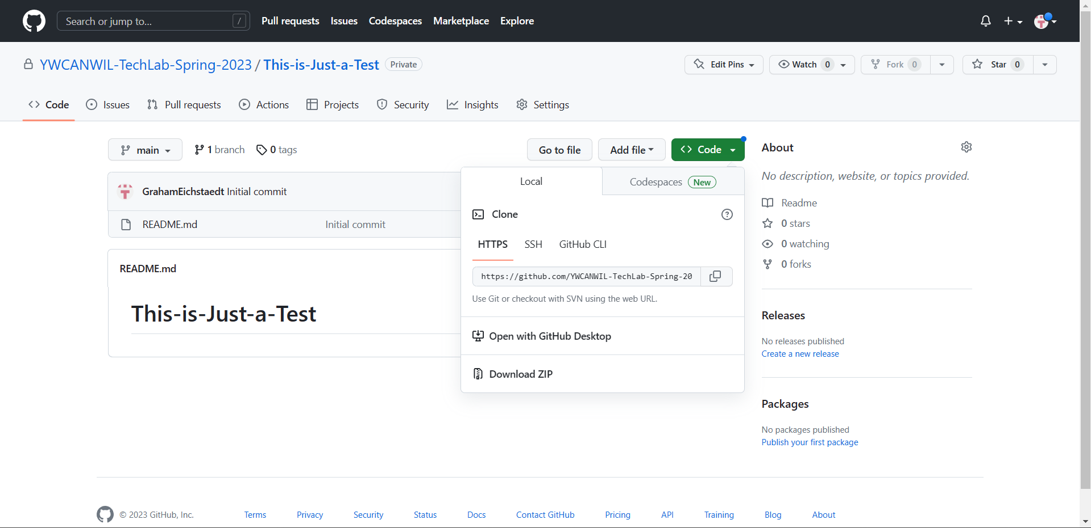
Creating a Repository
After you have created your repository, you will be taken to your new repo
Click on the green code button and copy the link to your repo under the HTTPS tab

Slide 17
Creating a Repository
Clone your repository using git clone, then paste the link you copied
Optionally, you can enter a name for your local directory by entering the name after the link
All together, it will look something like this: git clone https://github.com/user/repository.git my-project
Your Repository has been created! Try typing git status or git pull to make sure your repository is up to date

Slide 18
Interacting with Your Repository
When you want to submit your work to a repo, your work needs to be commited
First, navigate to your repo
Then, select all the files you would like to add to your repo using git add followed by all the files you would like to add
Ex: git add file1.html file2.css file3.js file4.txt
Next, use git commit –m “Type a message here” to commit your files to the version history and leave a message in your repository describing your change

Slide 19
Interacting with Your Repository
Finally, use git push to upload your changes to GitHub
Your files will now be visible in their repository and will display the message you typed when you committed
Your GitHub Repos will display your projects to the world and are a great way to show off your programming experience to the world (and especially employers)

